Slide 1
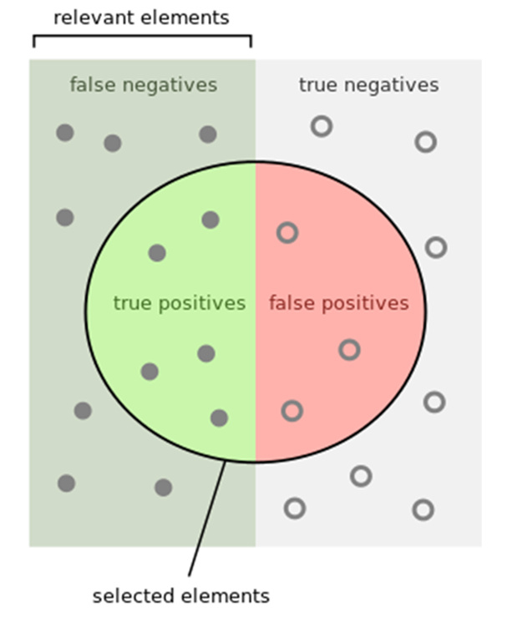

1. Predictive Accuracy
Using K-fold cross validation
Accuracy =
Number of correct classifications
Number of instances classified
$$Accuracy=\frac{tp+tn}{tp+tn+fp+ fn}$$

Slide 2
True labels [1, 1, 1, 1, 1, 1, 1, 1, 1, 2]
Pred labels [1, 1, 1, 1, 1, 1, 1, 1, 1, 1]
True labels [1, 1, 3, 1, 2, 1, 2, 1, 1, 2]
Pred labels [1, 1, , 1, , , 2, 1, , ]

Slide 3
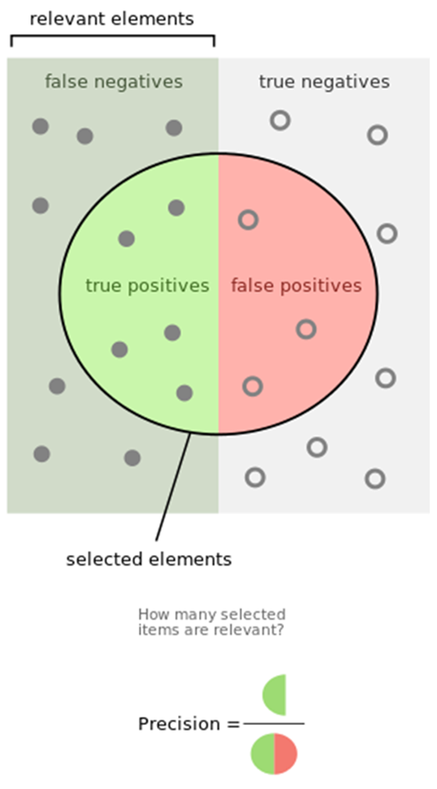

Precision
It’s a positive predictive value
It’s the fraction of relevant instances among the retrieved instances
$$Precision=\frac{|\{relevant_documents\}∩\{retrieved_documents\}|}{|\{retrieved_documents\}|}$$
$$Precision=\frac{tp}{tp+fp}$$

Slide 4
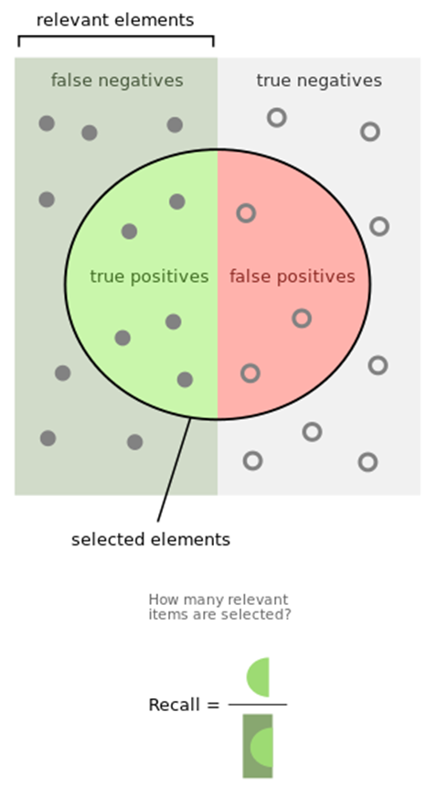
Recall
It’s the sensitivity
It’s the fraction of relevant instances retrieved over the total amount of relevant instances
$$Recall=\frac{|\{relevant_documents\}∩\{retrieved_documents\}|}{|\{relevant_documents\}|}$$
$$Recall=\frac{tp}{tp+fn}$$

Slide 5

F-measure or F1 score
It’s the harmonic mean of precision and recall
$$F1=\frac{2}{\frac{1}{recall}+\frac{1}{precision}}=2\frac{precision∙recall}{percision+recall}$$

Slide 6
Confusion Matrix
Accuracy is a single number, we may be better off looking at a confusion matrix. This gives us additional useful information…
True label is...
 | Cat | Dog | Duck
Cat | 100 | 0 | 0
Dog | 9 | 90 | 1
Duck | 45 | 45 | 10
Classified as a…

